Slide 1
Big Data & IoT
IoT600, Introduction
Mr N. Mathenjwa

Slide 2
Lecturer’s bio
Mr. Nqubeko Mathenjwa
Email address: nqubekom@Richfield.ac.za
Room: 8th floor
University of KwaZulu-Natal –Westville (KZN 2019)
Currently doing MSc in Computer Science
University of KwaZulu-Natal –Westville (KZN 2018)
Completed Bachelor of Science Honours in Computer Science
University of KwaZulu-Natal –Westville (KZN 2017)
Completed Bachelor of Science in Computer Science and Information Technology

Slide 3
Timetable
 | 8:15 – 9:05 | 9:15 – 10:05 | 10:15 – 11:05 | 11:15 – 12:05 | 12:15 – 13:00 | 13:00 – 13:50 | 14:05 – 14:55 | 15:05 – 15:55
Monday |  | IOT 600 BSc-Art Rm 102 | Prog 732 (P) BSc Lab 1001 | Prog 732 (P) BSc Lab 1001 | Prog 732 (P) BSc Lab 1001
Tuesday | Prog 632 (P) DIT Lab 1205 | Prog 632 (P) DIT Lab 1205 | Prog 632 (P) DIT Lab 1205 | IOT 600 BSc Rm 1004 |  |  | ITGP 700 BSc Rm 102
Wednesday |  | Prog 742 (P) BSc Lab 1205 | Prog 742 (P) BSc Lab 1205 | Prog 742 (P) BSc Lab 1205 | Prog 732 BSc Rm 102 |  | IOT 600 BSc Rm 1004
Thursday | IOT 600 BSc-Art Rm 102 | Prog 732 BSc Rm 102 | Prog 742 BSc Rm 102 | SM 700 BSc Rm 102 | Prog 632 DIT Rm 1202
Friday | SM 700 BSc Rm 102 | Prog 632 DIT Rm 1202 | IOT 600 BSc-Art Rm 102 | Prog 742 BSc Rm 102 | IOT 600 BSc Rm 1004

Slide 4

Textbook

Slide 5
Syllabus
■Chapter 1: Big Data Analysis and Extraction Techniques
■Chapter 2: IoT Architectures and Applications
■Chapter 3: Big Data Storage and Security
■Chapter 4: Big Data ethics, standards and policies
■Chapter 5: IoT technologies and Standards

Slide 6
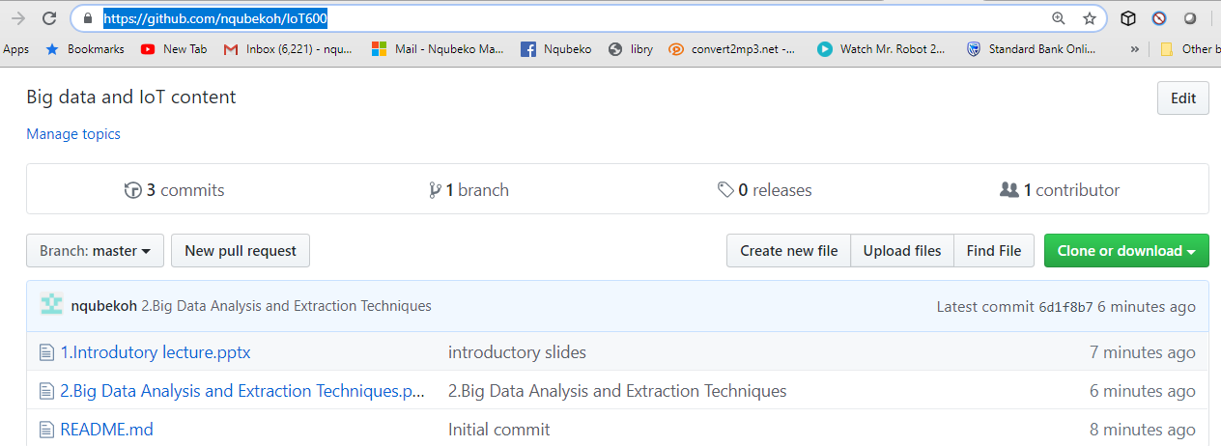
Github repository link
https://github.com/nqubekoh/IoT600

Slide 7
ClassRep details
Name: khumalo Sdududzo
Email address: khumalosduduzo8@gmail.com

